Slide 1
FrameFlow
2025HONGKONG
TECHATHON

Slide 2
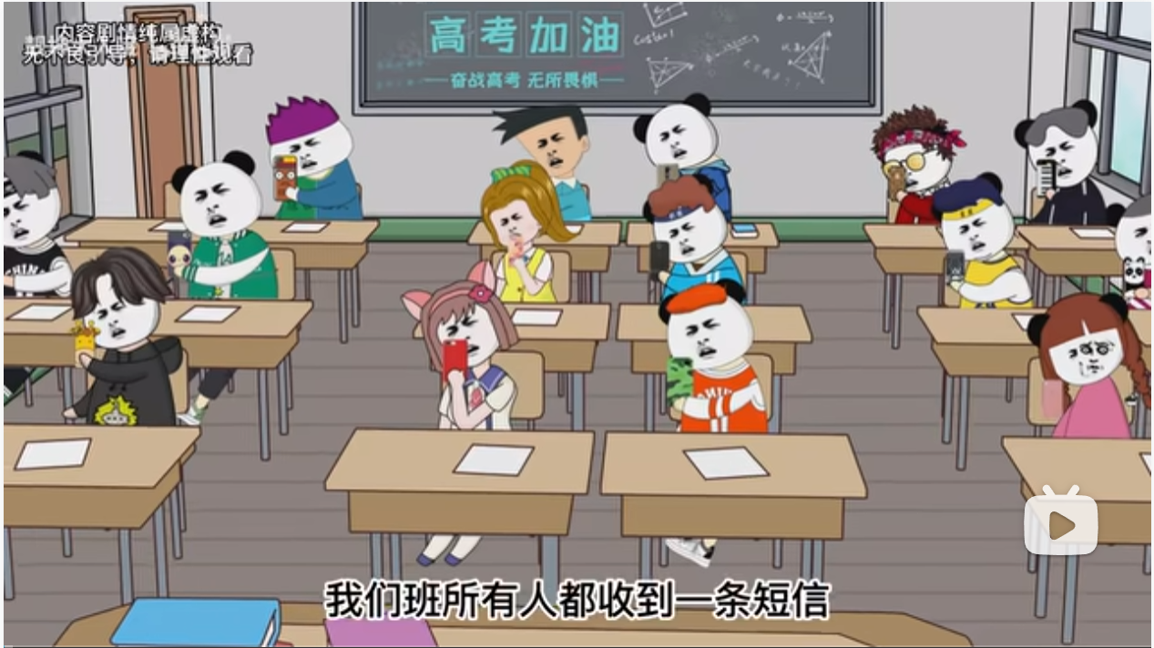
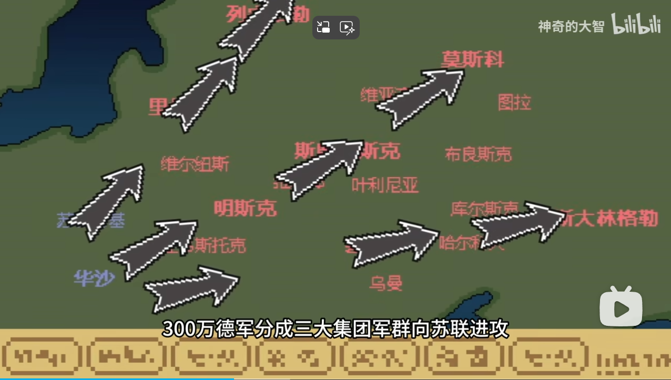
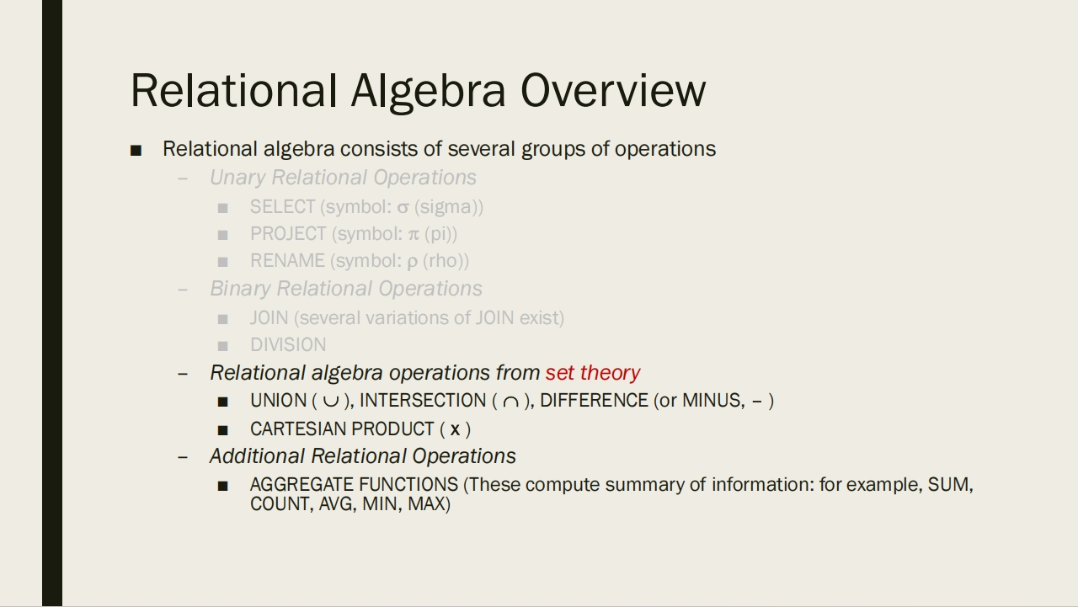

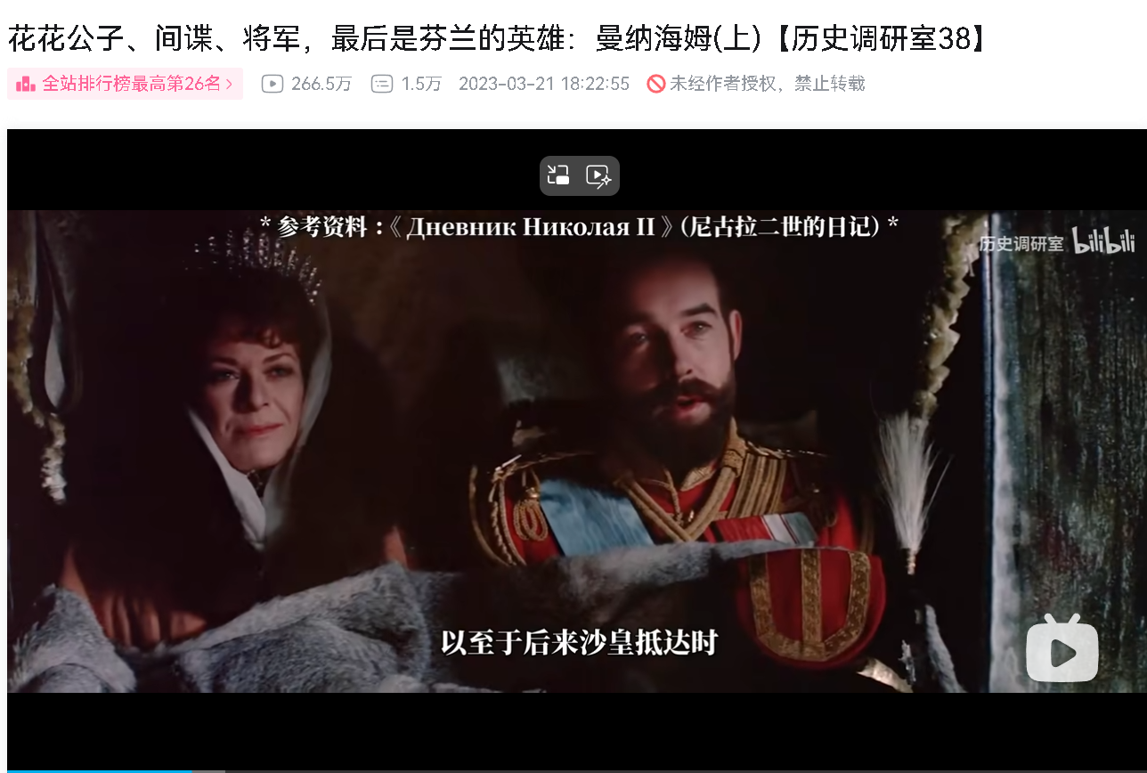

Pain Analysis
Vlogger
Education
Advertisement
Longer video writers often insert images unrelated to the content to fill in the video gaps:
The course slides are text-only and lack interest:
Businesses take a long time and are expensive to produce promotional videos:
Panda head
Rough GIFs
Film Footage
AI face swap video

Slide 3
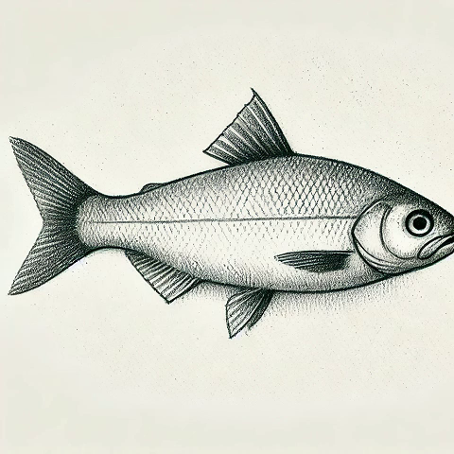
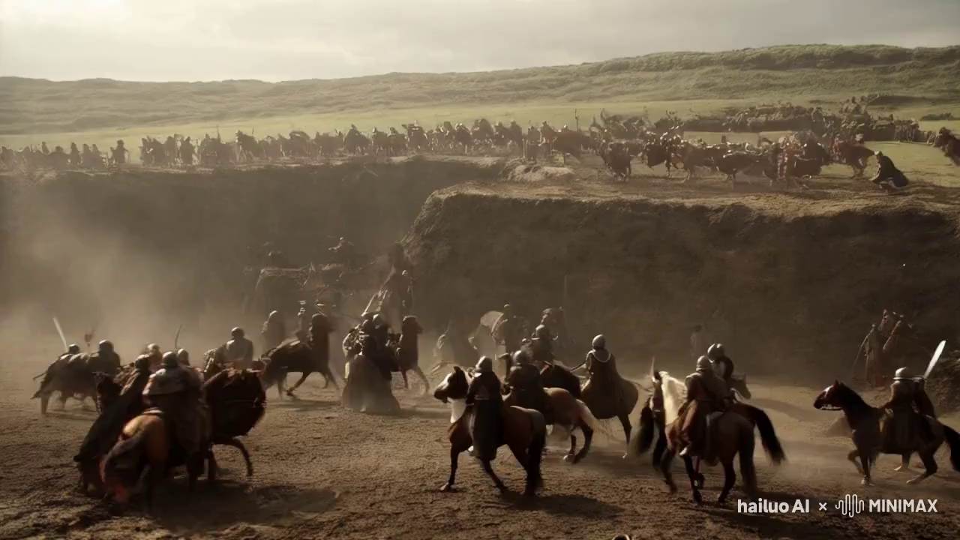
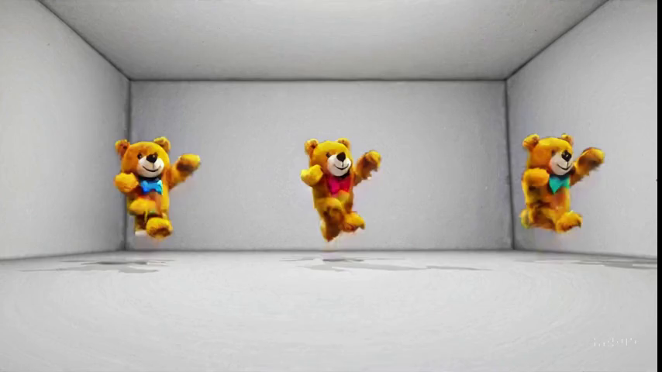
Usage Scenarios
Animating simple images
Restore historical scenes
Conceptualising videos
Bring the picture to life.
Restore the historical scene before the cameras.
Preliminary production of advertising video.

Slide 4
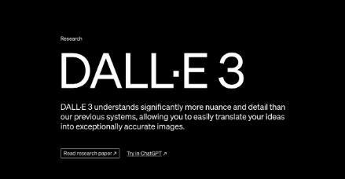

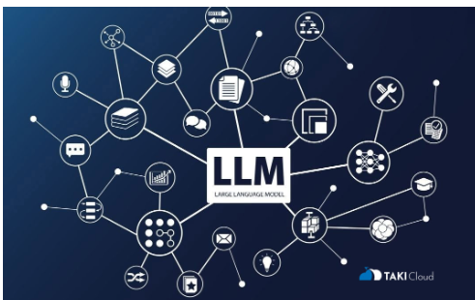
Technical Details
Large Language Model
Generating story outlines and subplots using models such as ChatGPT, Claude, and Mixed Meta using Big Language Models.
Video Generation Tools
Generate audio, video and footage using video generation tools Sora, Luma, Runway, Hailuo, and more.
Image Generator
Use image generators Midjourney, Stable Diffusion, DALL-E and other techniques to generate images.

Slide 5
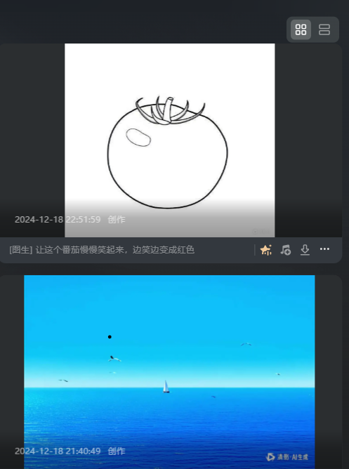
Product Description
Product Concept
We are going to build a one-click video generation platform. Integrate the capabilities of different models to focus on video generation.
Product Features
Concept→Video
Different customer segments
Amateurs: enter short ideas.
Vloggers: define video style.
Directors: Generate audio and video materials.
Usage Process
Enter creative ideas.
Select the video style and adjust the model parameters.
Fine-tune the split-screen content text.
Upload a still image or video or just remain concepts.
The platform generates multiple videos for your selection.

Slide 6
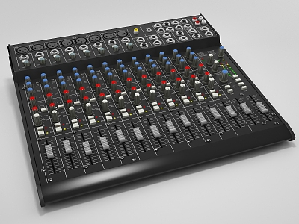








Public Welfare Property
Technology is changing the future, in order to improve the ability to create videos and promote video creation techniques. We offer free tutorials to our users through RAG system!
Full set of tutorials for beginners.
Additional AI assistance.
Beginners
Video style comparison.
Model parameter descriptions.
Complex Operation
Vloggers
Model Principle Analysis.
Video generation rules.
Free Tutorials
Technomania
Knowledge Payment
Retrieval Augmented Generation Question Answering System providing precise guidance and QA.

Slide 7
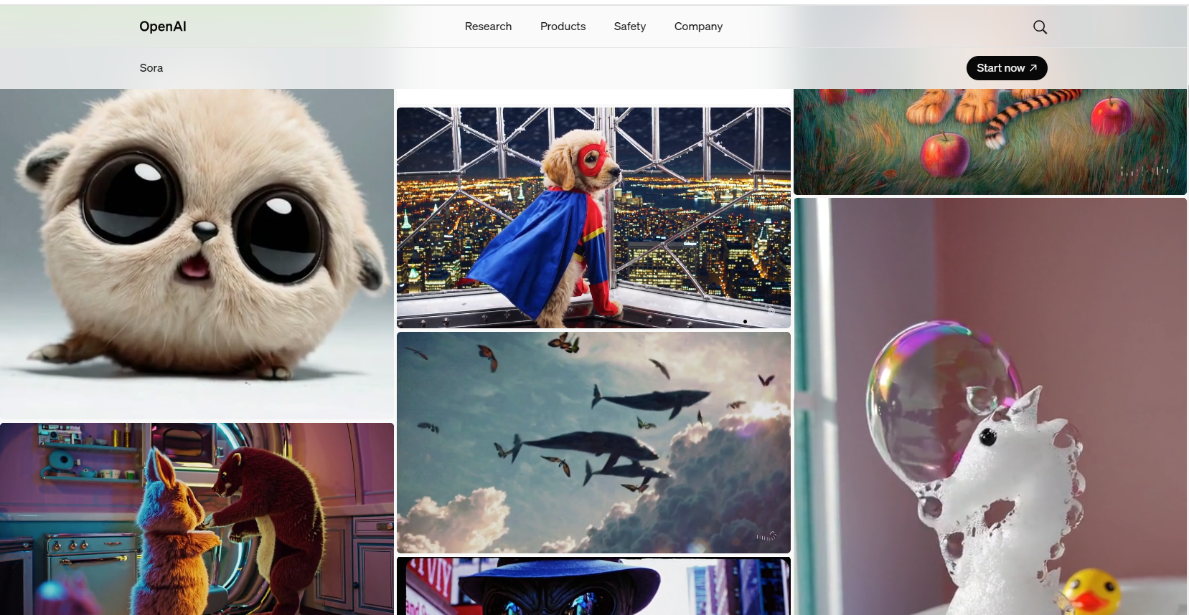
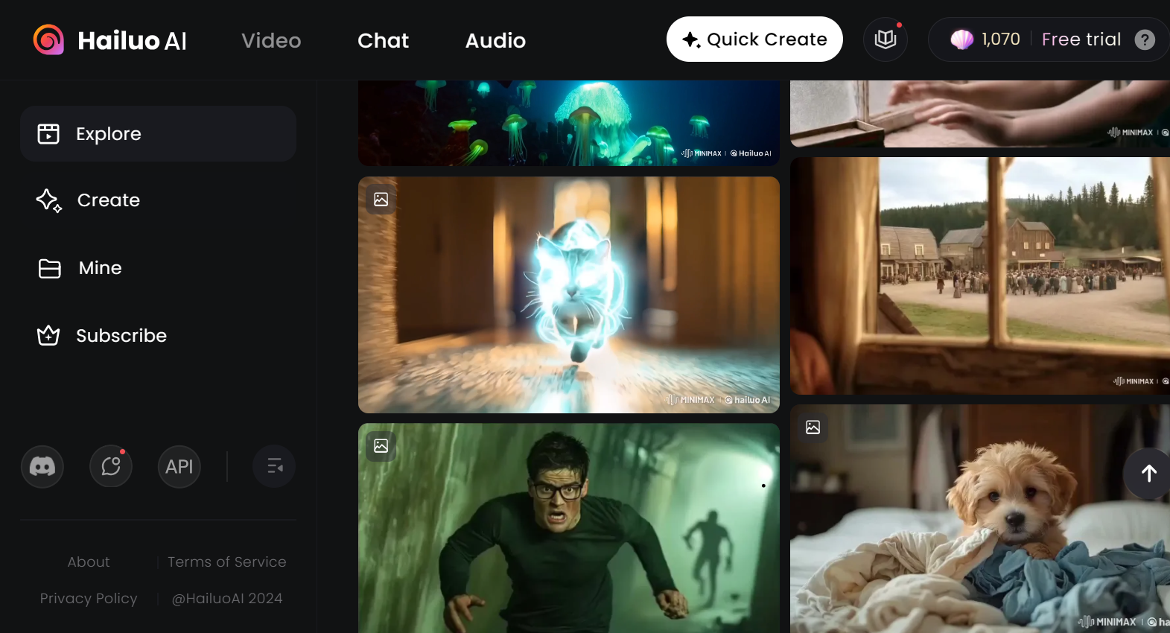
Competitive Research
Sora
Strengths：
fast and stunning generation
Disadvantages：
restriction on duration;
no sound for videos;
english input only;
restricted area registration;
海螺
Strengths：
multi-language input support
Disadvantages：
restriction on duration;
slow generation;
no sound in video;
FrameFlow aim to support long video generation, unlimited registration regions, multi-language input, video carrying voice-overs, provision of original footage packages and final products, and exclusive RAG customer service.

Slide 8
Advantage Analysis
Need
Trend
Change
integrate
The need for extensive video production exists in the market
Integrating Multi-modal
LLM without limitation of a single model
Our products follow the wave of AI creation
Fill in the gaps in existing products

Slide 9
Business Model
 | Try Free | Member 19HKD/M | Pro 39HKD/M | Enterprise 6280+HKD/Y | Customiation Actual Expenses
Video Generation | ✔ | ✔ | ✔ | ✔ | ✔
More Use Times |  | ✔ | ✔ | ✔ | ✔
Long Video Length |  |  | ✔ | ✔ | ✔
High Resolution |  |  | ✔ | ✔ | ✔
Corporate Account |  |  |  | ✔
Open Interface |  |  |  | ✔ | ✔
Dedicated Server |  |  |  |  | ✔

Slide 10




Milestone
Q1
Q2
Q3
Q4
Upload the website and test run the product
Contact your school to provide a public test of the product and gather feedback
Ongoing operations and promotion on streaming platforms
Integrate more than 3 models
Complete web design
Validate product flow
Build development frameworks
Build RAG AI QA system
Write 5+ tutorials
Complete the first iteration of the product
Add video style memory
Add profile import and export function
Test product modules
Continuous iterative development

Slide 11
2025Jan
Thanks for watching!

